Slide 3
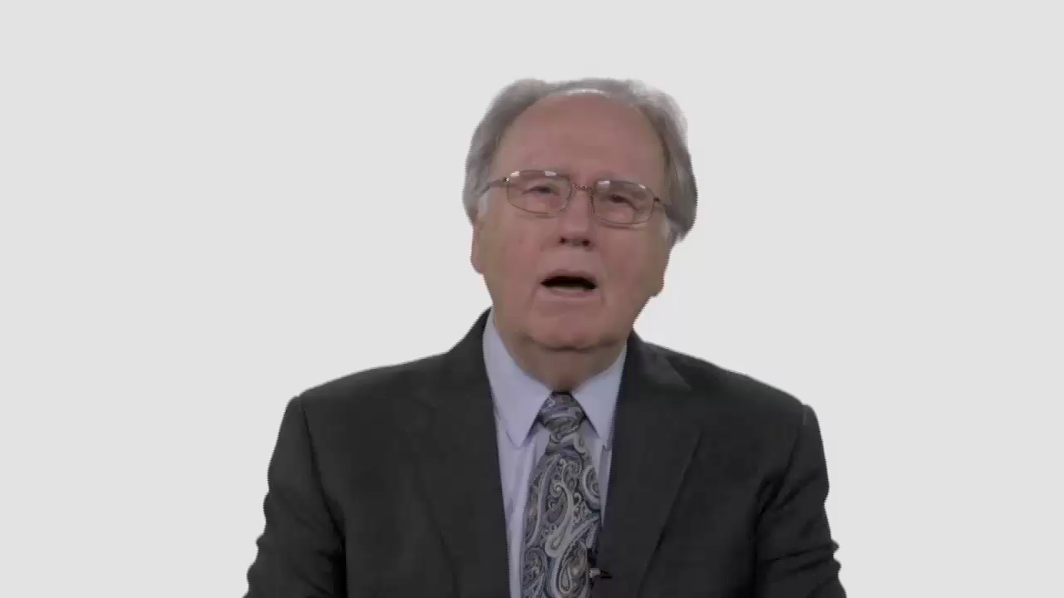

Slide 4
Have Your Say.
What are the most important messages people need to hear
about marriage and cohabitation?

Slide 5
Conversation Builders.
What are some of the negative stereotypes about marriage people absorb from what they watch or read?

Slide 6
Conversation Builders.
Why do you think people who
live together before marriage end
up less satisfied with their marriage
than people who don’t?

Slide 7
Conversation Builders.
Do you think fear of commitment
is driving the trend toward cohabitation over marriage?

Slide 8
Discussion Questions.
What makes a marriage,
a marriage?

Slide 9
Discussion Questions.
How far do you think our
attitudes toward marriage are
shaped by the examples we see
in our family or church?

Slide 10
Discussion Questions.
Is there more we should be
saying or doing to tell young
people what the Bible says about
marriage and relationships?

Slide 11
Discussion Questions.
Is the climate of your congregation one that would encourage young people to seek guidance and support if they’re struggling with relationship issues?

Slide 12
What Now?
What specific resources or programs could your congregation provide
to help young people form
healthy relationships?

